Slide 1
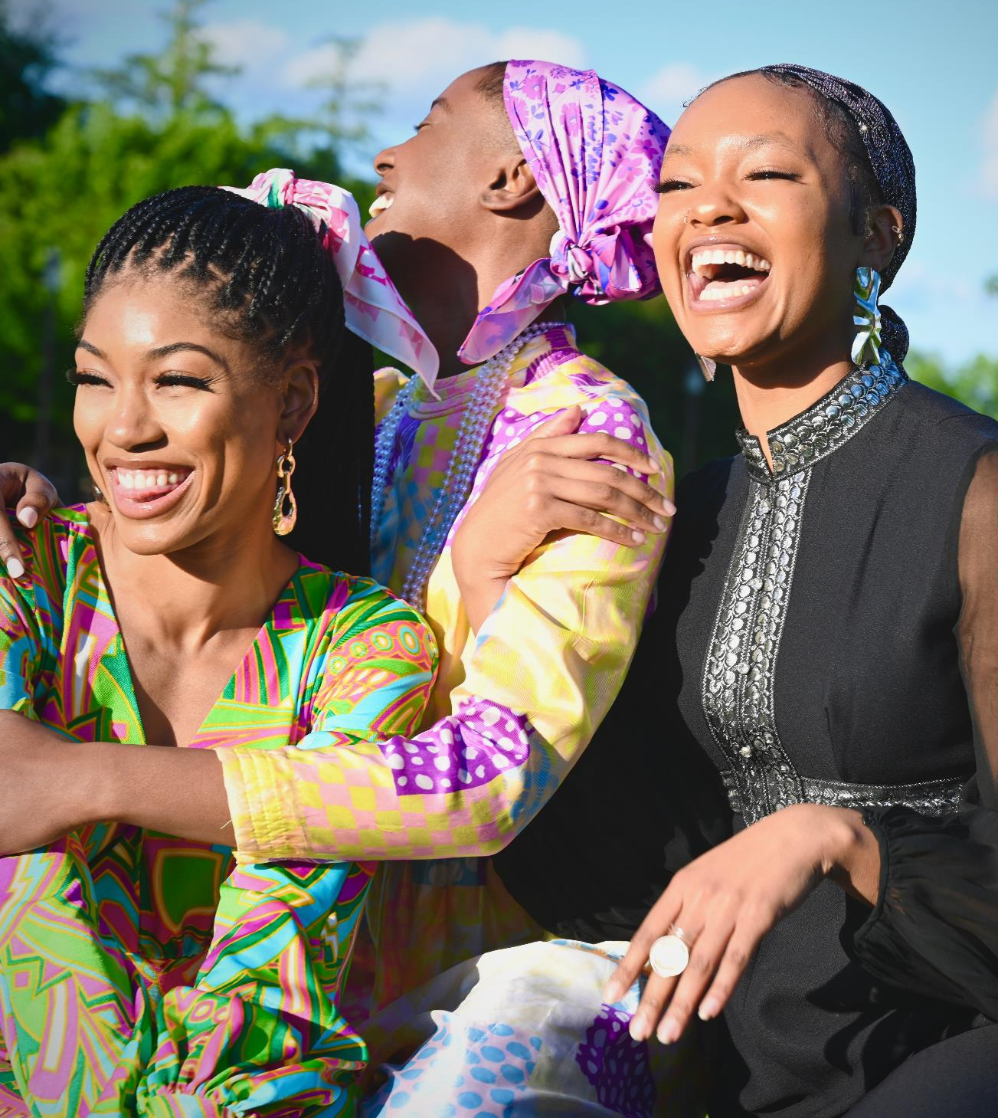

HEALTHY WOMAN FOUNDATION
A PRESENTATION BY SAPPHIRE LADIES (GROUP 4)

Slide 2

TABLE OF CONTENT
About Healthy Woman Foundation
Problem Statement
SDGs that inspired us
Mission and Vision statement
Plan
Snippets
Team members

Slide 3
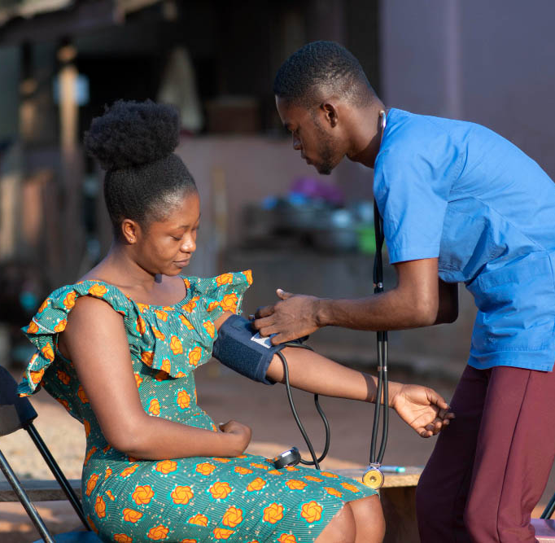
About Us
The Healthy Woman Foundation is a non-governmental organization dedicated to empowering and educating African women, notably those living in rural areas.
This NGO was founded by Sapphire ladies (Group 4) in Tech4Dev 2.4 cohort (Software Development).
We believe that empowering women with health information will reduce morbidity and mortality while also promoting good health and well-being among all members of society.

Slide 4
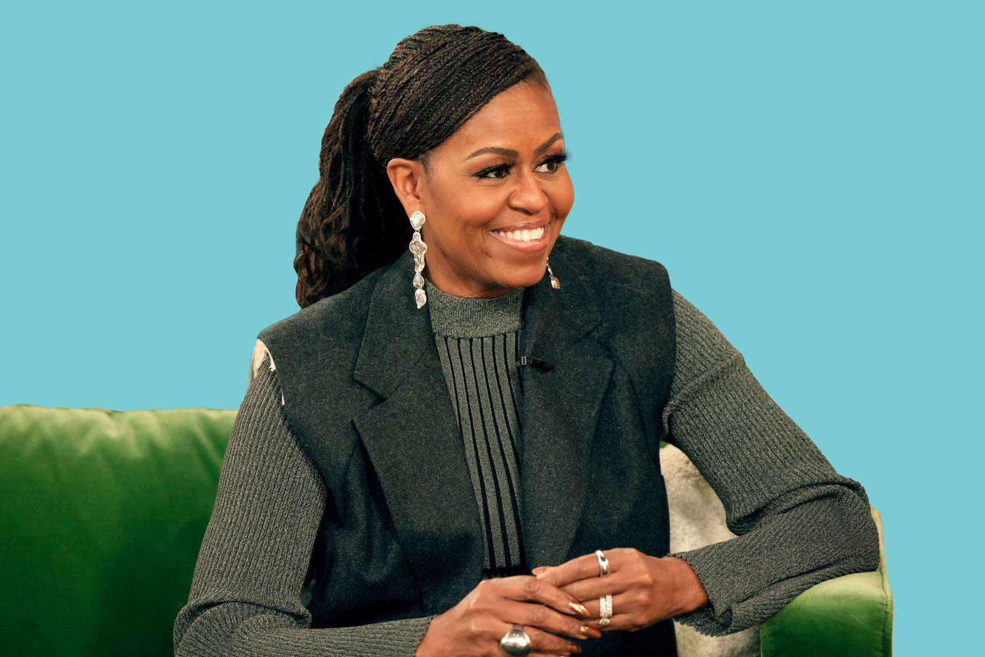

“Communities and countries and ultimately the world as only as strong as the health of their women.”
-Michelle Obama

Slide 5
Problem Statement
Pregnancy and childbirth
Sexually transmitted infections
Non-communicable diseases
Women in developing countries account for 95% of those who die every day as a result of pregnancy and childbirth.
In Africa, women account for approximately 58% of those infected with STIs. Teenagers girls are 5 times more likely than boys their age to be HIV positive.
Non-communicable diseases such as diabetes, cancer, and hypertension are the leading causes of death in older African women.

Slide 6

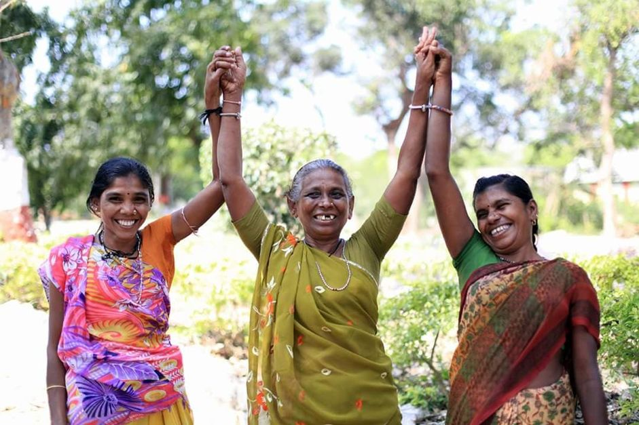
Sustainable Development Goals
Goal 3
Goal 5
Ensure healthy lives and promote well-being for all at all ages
Achieve gender equality and empower all women and girls
Notes:
Download more minimal templates here: https://crmrkt.com/GK9Dwa

Slide 7
OUR VISION
We seek to build a community that empowers girls and women to make healthier choices and take more control over health-related decisions.
Our Vision
WOMEN EMPOWERMENT FOR HEALTHIER LIVES
Notes:
Download more minimal templates here: https://crmrkt.com/GK9Dwa

Slide 8
OUR MISSION
The Healthy Women Foundation strives to give women a forum for learning about health issues, donate supplies like menstrual kits to teenage girls in rural and urban areas, and work with policymakers and key stakeholders to enhance the standard of care that women receive.
Our Mission
PROVIDE A FORUM TO EDUCATE,EMPOWER AND DONATE
TO AFRICAN WOMEN
Notes:
Download more minimal templates here: https://crmrkt.com/GK9Dwa

Slide 9

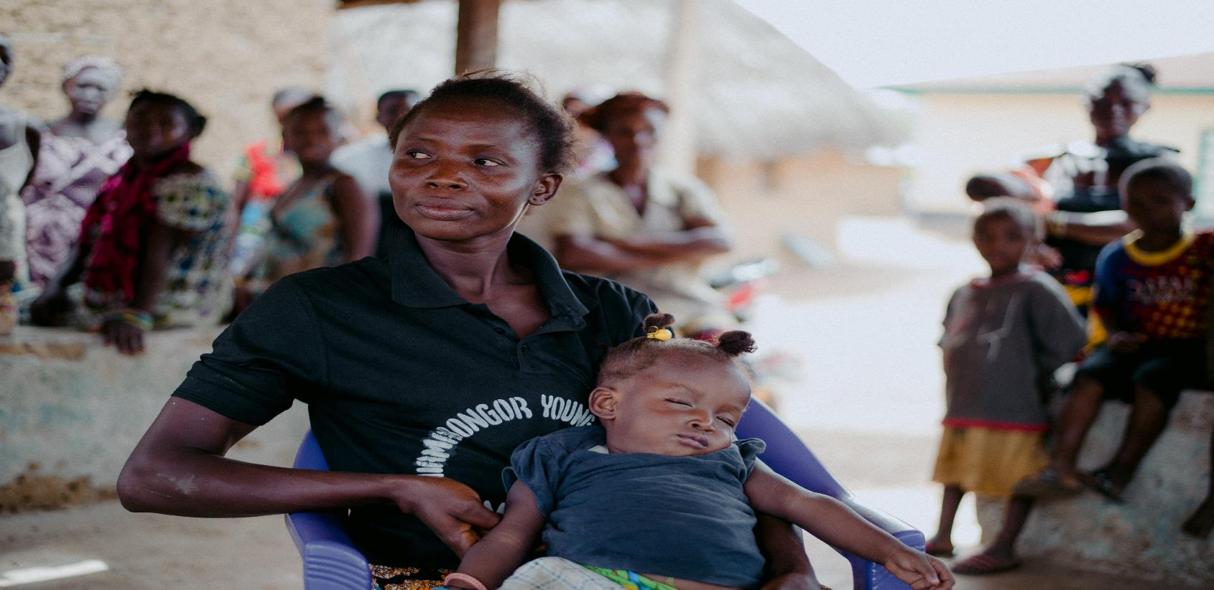
PLAN
Create an easily accessible and navigable website that provides blog posts, videos, and occasional online conferences to educate and empower women.
Conduct health outreach initiatives in remote communities with skilled health professionals to screen for non-communicable diseases such as breast cancer, cervical cancer, and hypertension and make a referral to appropriate treatment facilities.
Notes:
Download more minimal templates here: https://crmrkt.com/GK9Dwa

Slide 10
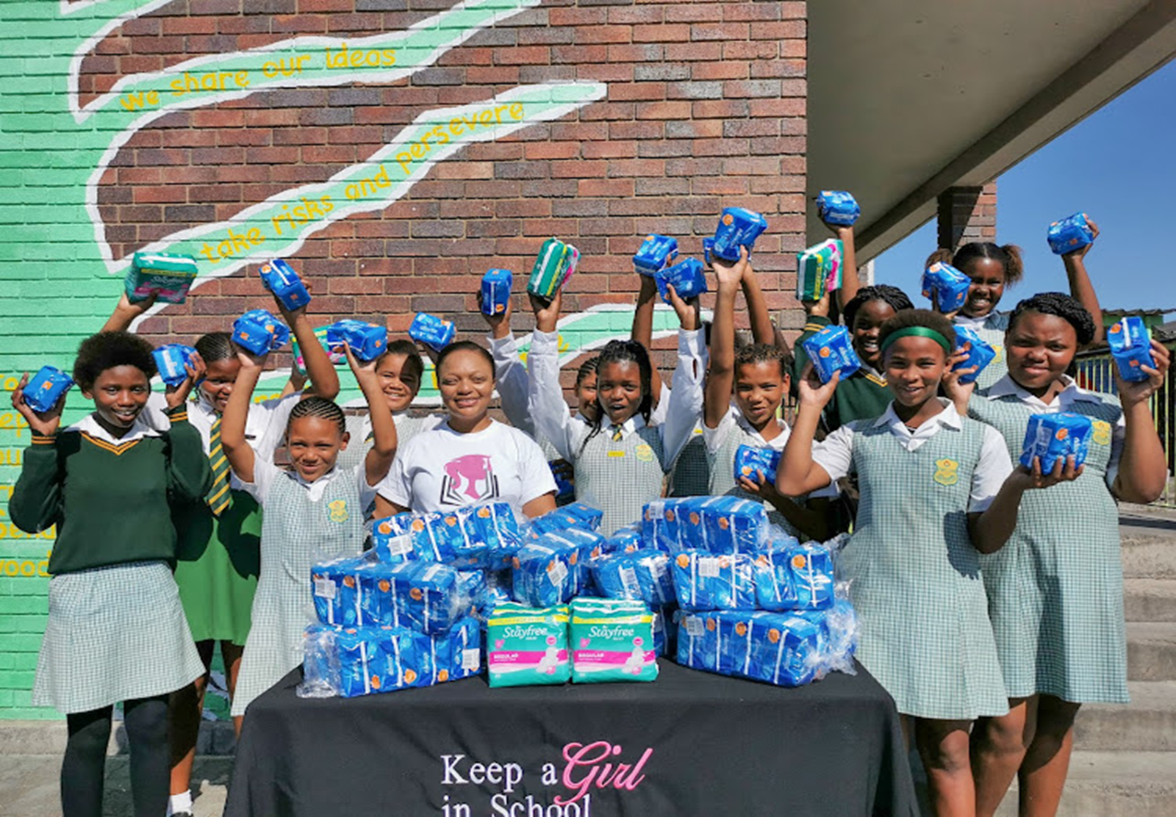
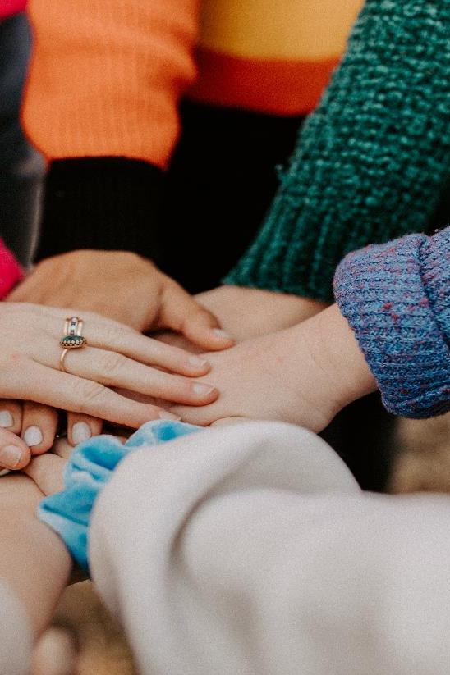
PLAN
Give teenagers more information about their reproductive health, while also providing items such as books and menstruation kits.
Work together with policymakers and community stakeholders to enhance the standard of women's healthcare.
Notes:
Download more minimal templates here: https://crmrkt.com/GK9Dwa

Slide 11
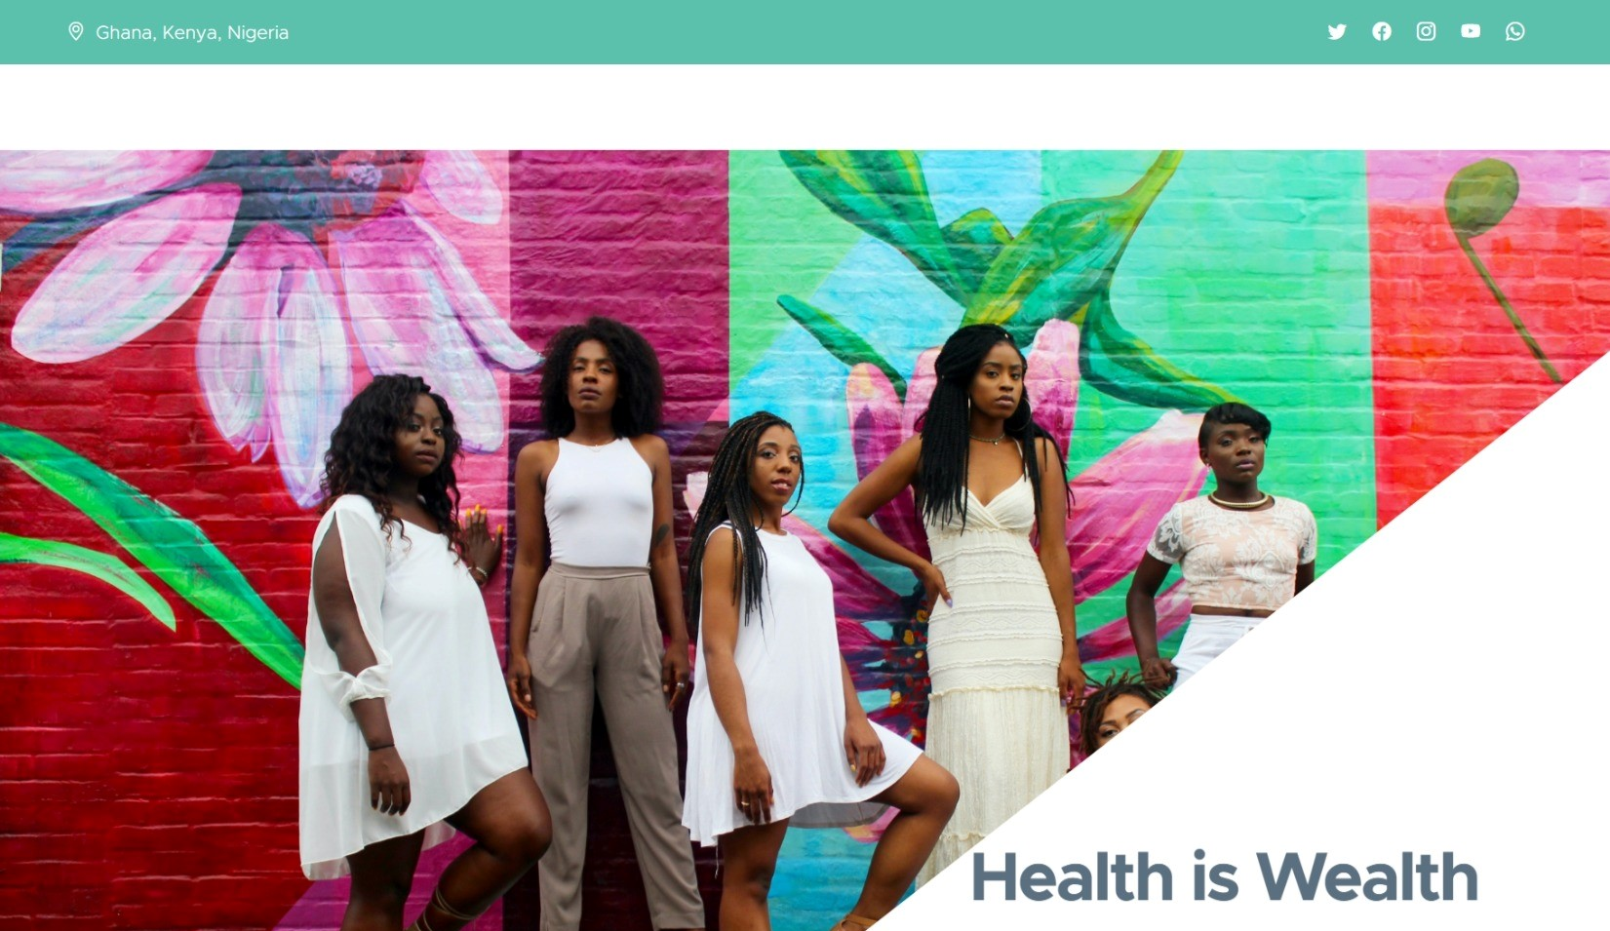

Slide 12
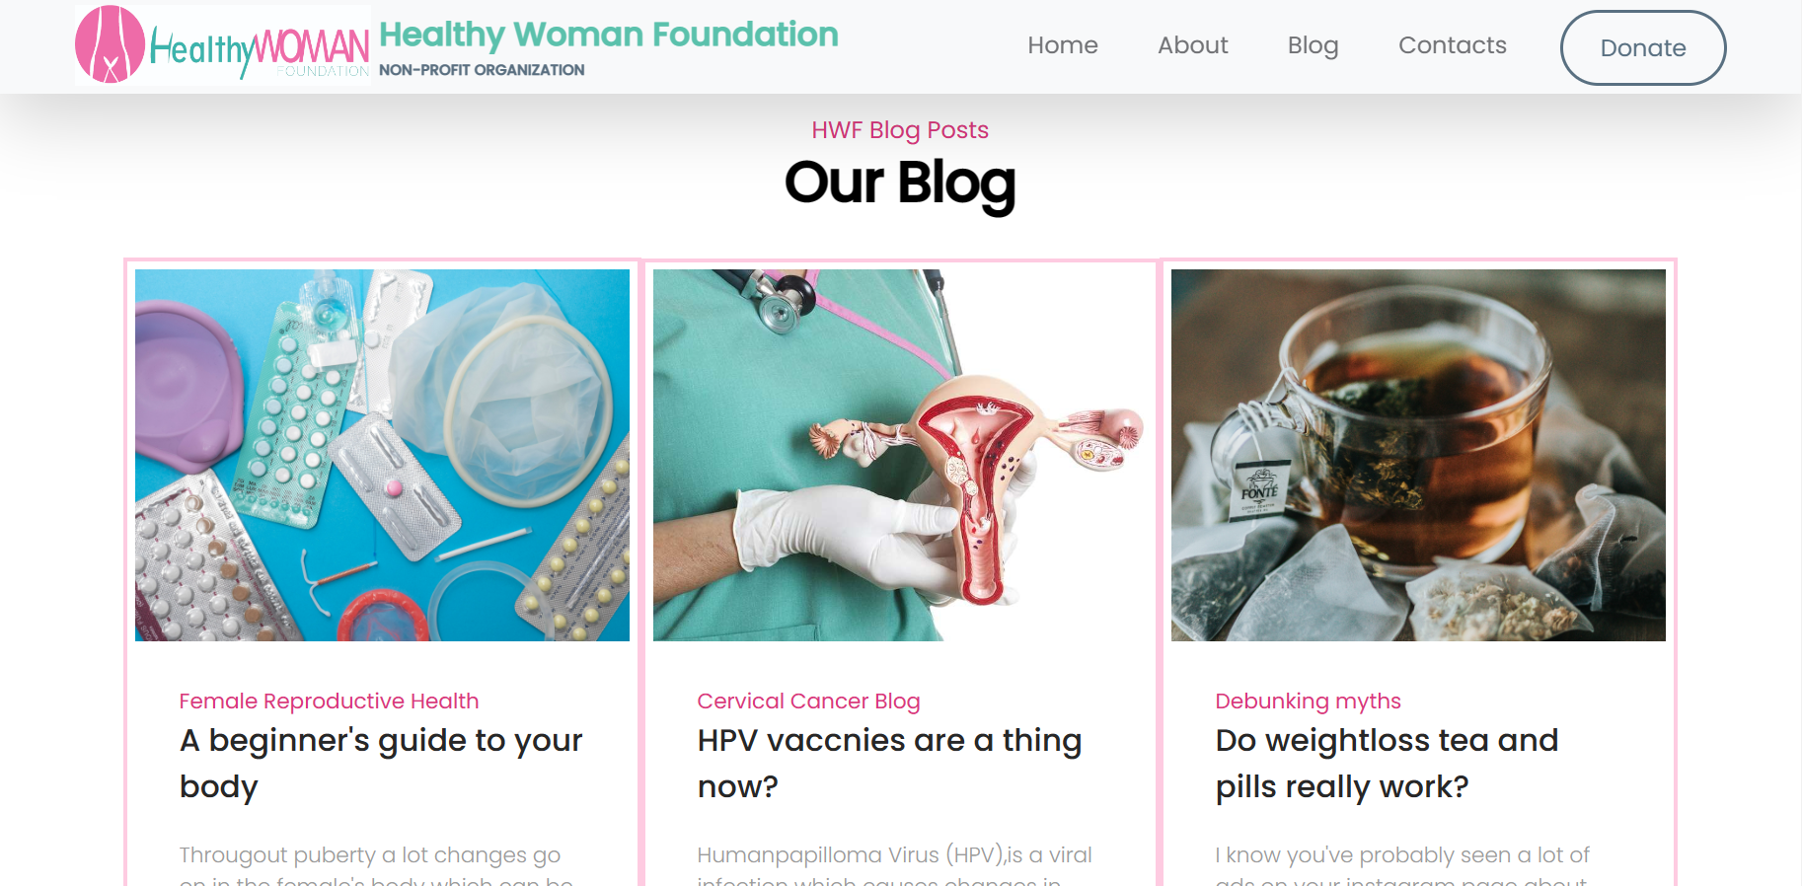

Slide 13
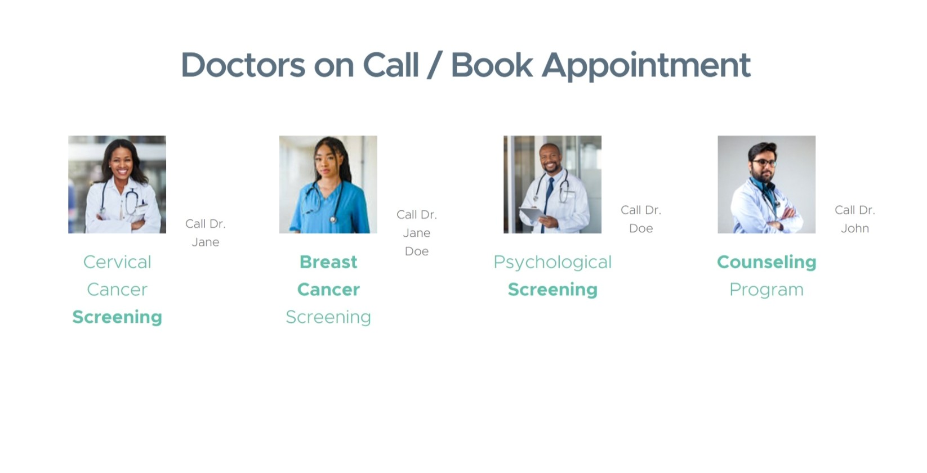

Slide 14
Baaba Yaaba Amoah-Team Lead
Blessing Nwalozie
Nicolle Akuffo
Ruth Moyo
Bomkazi Nyeliso
Ruth Jemutai
Janet Otieno
Faith Wambui
Sarah Wanyeki
Akeyo Orero
Nkiruka Nelson
Agnes Koinange
Joy Kwamina
Favour Attah
TEAM MEMBERS

Slide 15
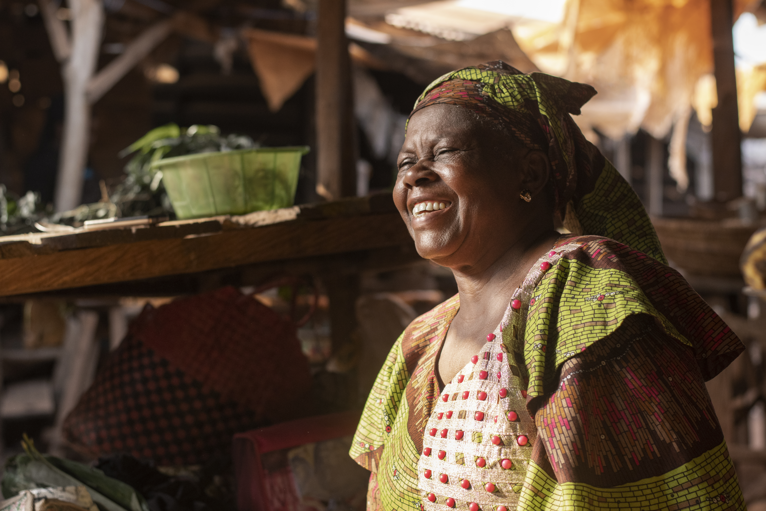
THANK YOU!

